Slide 1
بسم الله الرحمن الرحيم

Slide 2
BIOENERGETICS
Dr. Naglaa Ibrahim Mohamed Azab
Assistant Professor of Medical Biochemistry
naglaa1270@yahoo.com

Slide 3
Items
1.Definition of metabolism and its classification and stages of catabolism.
2.what is energy, its benefits, How can the energy be captured.
3. Mechanism of electron transport ( ATP production) and its regulation

Slide 4
METABOLISM
Is all of the chemical processes of the cell
Chemical reactions result in
Synthesis of
organic compounds
Degradation of organic compounds
A + B AB
Energy
Energy
AB A + B
ANABOLISM
CATABOLISM
endergonic
exergonic
Eg. Synthesis of glycogen, triglycerides & proteins
Eg. Oxidation of glucose, fatty acids & a.a.s

Slide 5
METABOLISM
CATABOLISM
Breakdown (Degradation) of complex molecules
Exergonic = releases energy
e.g.
Oxidation of glucose
Oxidation of fatty acids
ANABOLISM
Building up (Synthesis) of complex molecules
Endergonic = consumes energy
e.g.
Biosynthesis of glycogen, triacylglycerols and proteins

Slide 6
Stages of catabolism
of the main metabolites
Polysaccharides
Triglycerides
Proteins
Stage 1 → minimum energy
Monosaccharides
glycerol + f.as
a.as
Stage 2
→ some energy
Acetyl coA (Active acetate)
Krebs cycle
Stage 3
→ maximum energy
CO2+H2O
+
Reduced coenz. ( H carriers)
Respiratory chain
ENERGY

Slide 7
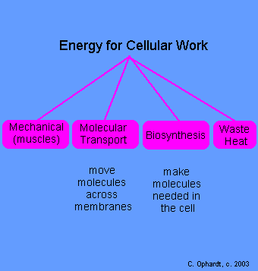
Energy
Is the capacity to do work

Slide 8
Energy is stored in the form of chemical bonds
High energy bond | Low energy bond
∼7-15 kcal | ∼2-4 kcal | On hydrolysis releases
Curved line (∼) | Straight line (-) | Represented by
1- High energy phosphate bonds as; Pyrophosphate bond:ATP Phosphate carboxylate bond Phosphate enol bond creatine phosphate Bond 2- High energy sulfur bonds As , Thioester bond: Acetyl COA ,succinyl COA. | *Peptide bond(a.a-a.a) *glycosidic bond (Glu- Glu) *Ester bond as in TAG (Fa-alchol) (CH2-O-CO-R) *Phosphate ester bond as Glucose 6-P (CH2-0-P) | Examples

Slide 9
pyrophosphate bond :
ATP: Adenosine-P∼P∼P , ADP, AMP(??)
Carboxylate phosphate bond:
1,3 biphosphoglycerate:
CO-O∼P
Enol phosphate bond:
2 phosphoenol pyruvate (enol;alchol)
CH2=C-O∼P
Thioester bond:
Acetyl COA:
R-CO∼S-COA (ester between carboxylic acid & thiol)

Slide 10
Mechanisms of collection of released energy: Released energy is collected in the form of ATP at two levels:
Oxidative Phosphorylation
The main source of energy
It occurs in mitochondria by the Respiratory Chain enzymes [=Electron Transport Chain (ETC) enzymes]
Substrate Level Phosphorylation
Very small amount
Few reactions can form ATP at substrate level: e.g.
Phosphoglycerate Kinase
Pyruvate Kinase (glycolysis)
Succinate thiokinase (succinyl COA)(KREBS cycle)

Slide 11
The Electron Transport Chain
(ETC) (Respiratory chain)

Slide 12
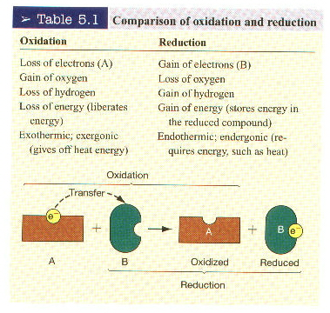
In ETC there is a series of oxidation-reduction reactions ending in the production of energy

Slide 13
Oxidation of the food we eat (CHO, lipid, proteins)
→ ENERGY
HOW?

Slide 14
Reactions of oxidation of CHO, fat &proteins
Metabolic intermediates
H
Hydrogen carriers
(FAD OR NAD)
Reduced coenzymes
(FADH2 OR NADH+H)
2H⁺& 2e⁻
SERIES OF HYDROGEN and electron carriers (ETC)
ATP

Slide 15
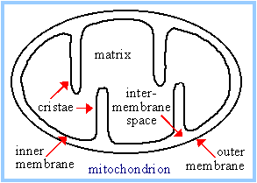
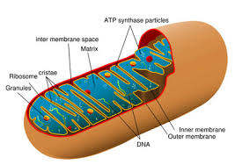
ETC consists of
A series of hydrogen and electron carriers located in the inner mitochondrial membrane

Slide 16
Substrate as succinate,acetyl COA &glycerol-3-P`
H2O
FADH2
2H⁺
SH2
NAD
FMNH2
COQ
2Fe⁺²
2Fe⁺³
2Fe⁺²
2Fe⁺³
O
Cyt b
Cyt c1
Cyt c
Cyt a
Cyt a3
S
NADH+H⁺
FMN
COQH2
2Fe⁺²
2Fe⁺³
2Fe⁺³
O2
2Fe⁺²
ATP
ATP
ATP
Enzyme complexes fixed to the inner mitochondrial membrane:
Complex I : Flavoprotein containing FMN (coenzyme) acting as H carrier
Complex II : Flavoprotein containing FAD (coenzyme) acting as H carrier
Complex III : Hemoprotein formed of cytochrome b,c1
Complex IV : Hemoprotein formed of cytochrome a,a3
Enzyme complexes not fixed to the inner mitochondrial membrane:
- Co Q - Cytochrome c

Slide 17
1- Enzyme complexes fixed to the inner mitochondrial membrane:
Complex IV | Complex III | Complex II | Complex I
Hemoprotein | Hemoprotein | Flavoprotein | Flavoprotein
cytochrome c oxidase (cytochromes a,a3) | Q cytochrome c oxidoreductase (cytochromes b&c1) | Succinate Q oxidoreductase (succinate dehydrogenase | NADH-Q oxidoreductase (NADH dehydrogenase) | Enzyme
--- | -- | FAD | FMN | H carrier
copper& heme iron atoms | 1Fe-S group | FAD 2Fe-S groups | FMN 7Fe-S groups( non heme iron) | E carrier
Transfer electrons from cytochrome c to O2. | Transfers e from COQH2 to cytochrome c with liberation of 2 H+ | Transfer H& e from Succinate to CO Q | Transfer H& e from NADH+H to CO Q | Function

Slide 18
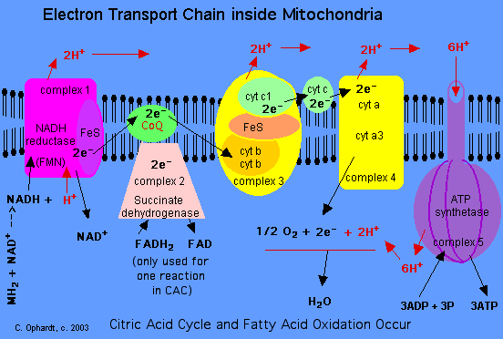
Intermembrane space
MATRIX

Slide 19
2- Mobile enzyme complexes ( not fixed to the inner mitochondrial membrane):
Include :
CO Q: is lipid soluble and freely diffuses through the inner mitochondrial membrane
Cytochrome c: is water soluble
2-Complex V: ATP synthase

Slide 20
*In complexes I,II&III, Fe-S (non heme iron) take part in single electron transfer reactions in which one Fe atom undergoes oxidoreduction between Fe³⁺ & Fe^{2+ .}
*In complex I: electrons are transferred from NADH+H to FMN initially, then a series of Fe-S centres, and finally to CO Q .
*In complex II: FADH2 is formed during the conversion of succinate to fumarate in the krebs cycle and electrons then pass via several Fe-S centres to CO Q . Also glycerol 3-P (from breakdown of TAG or glycolysis & acyl COA also pass electrons via pathways involving flavoproteins.
*Cytochrome oxidase:
is single protein containing 2 molecules of heme (2 prothetic groups) ,each having one iron atom that oscillates between Fe³⁺ & Fe²⁺ during oxidation –reduction reactions.
It also contains :
2 copper atoms that are linked to S (like Fe-S in complexes I,II&III ). They transfer e- to cytochrome a
another copper centre is linked to heme a3 to transfer electrons from cyt a3 to O2 .

Slide 21
Oxidation of NADH + H⁺ in respiratory chain → 3 ATP i.e. starting by NADH + H⁺ → 3 ATP.
Oxidation of FADH₂ in respiratory chain → only give 2 ATP.

Slide 22
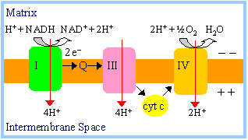
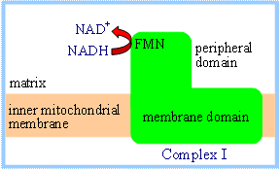

Slide 23
Mechnism of oxidative phosphorylation
Chemisomotic theory of ATP synthesis:
The energy released from the passage of electrons along the hydrogen and electron carriers of the respiratory chain is used to pump hydrogen ions (Protons) through complexes I,III&IV from mitochondrial matrix to space between the inner and outer membranes (Intermembrane space),creating potential difference across the inner membrane which is impermeable to protons (Each of the complexes I,III&IV acts as proton pump that translocates 2-4 protons across the inner mitochondrial membrane)
ATP synthase enzyme (complex V) consists of two subunits,F0 and F1.Through the F0 subunit, protons return to the mitochondrial matrix according to their concentration gradients, The F1subunit couples ADP with Pi to form ATP.
F0 span the inner mitochondrial membrane, while F1protein subunit project from F0 into the mitochondrial matrix.

Slide 24
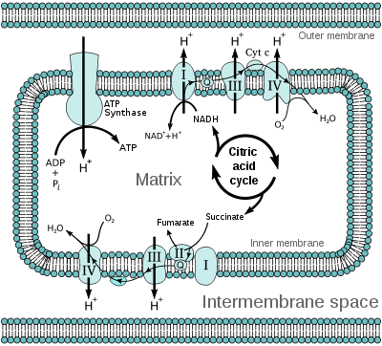

Slide 25
Oxidative Phosphorylation
The liberated free energy is used by ATP Synthase (Complex V) for the phosphorylation of ADP to form ATP:
ADP + P_{i} → ATP
This is called coupled “Oxidative Phosphorylation”; because the oxidation of the substrate and the phosphorylation of ADP are coupled together and must occur at the same time

Slide 26
ATP transporter (Translocator)
Its function is the translocation of ATP formed in respiratory chain from the mitochondria to cytoplasm in exchange of ADP to avoid inhibition of ETC by the accumulated ATP.

Slide 27
P/O ratio:
It is the ratio between inorganic phosphates consumed to form ATP in relation to oxygen atom reduced forming water in the respiratory chain.
1-In case of oxidation of NADH+H⁺ it is 3/1 (3 ATPs formed at 3 coupling sites),
2-in case of oxidation of FADH₂ it is 2/1 (2 ATPs formed at 2 coupling sites).

Slide 28
Electron Donors
Organic Compounds (Glucose preferred)
Electron Carriers as
NAD to NADH
FAD to FADH
Fe+3 to Fe+2
Cu+2 to Cu+
Electron Acceptors-Terminal
O₂ to H₂O
Phosphorylation Reactions
ADP to ATP

Slide 29
UNCOUPLERS OF OXIDATIVE PHOSPHORYLATION
Uncouplers are substances that dissociate oxidation from phosphorylation→ inhibition of oxidative phosphorylation by ETC.
They allow electron transport to proceed & oxidation of hydrogen with oxygen to form H₂O to proceed without phosphorylation of ADP to ATP (no ATP synthesis)
HOW????
Uncouplers allow leakage or transport of H+ across the membrane, thus collapsing the proton gradient for ATP synthesis
The free energy liberated during oxidation is lost as heat, so uncouplers cause the body temperature to rise (cause hotness)

Slide 30
Examples of uncouplers of Oxidative phosphorylation
2,4-Dinitrophenol (DNP) and Pentachlorophenol: drugs used to reduce weight
Warfarin: is a rat poison
Bilirubin: in abnormal high levels as in jaundice( not normally present in mitochondria in conc. high enough to affect normal function
Calcium: in large dose
Thyroid hormones (T3 & T4): in abnormal high levels as in hyperthyroidism. The action of physiological amount of thyroxine on the metabolic rate, is because it induces the synthesis of certain oxidative enzymes.
Toxins: of some bacteria and fungus

Slide 31
INHIBITORS OF ELECTRON TRANSPORT CHAIN
Selective inhibition of various components of the ETC can be achieved by using a variety of substances, some of which are used as poisons (e.g. insecticides), others as drugs
Examples:
Hydrogen cyanide (HCN), Carbon monoxide (CO), and sodium azide inhibit cytochrome oxidase. They are fatal
Rotenone: Used as an insecticide
Amytal: Used as hypnotic
Antimycin A: Used as antibiotic

Slide 32
Thank you

